Slide 1
Chapter 3:Brownian Motion
3.2 Scaled Random walks
Increments
Martingale
Quadratic Variation
Limiting Distribution
可看成Brownian motion 離散版

Slide 2
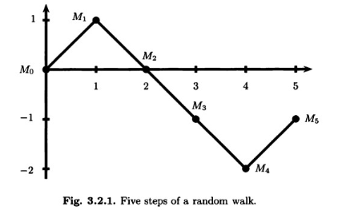

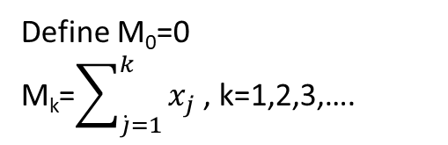
3.2.1 Symmetric Random Walk
Flippling a fair coin
其中w_{j}為第j次所發生的結果
Define M₀=0
M_{k}=$\sum_{\dot{j}=1}^{k}{x_{j}}$ , k=1,2,3,….

Slide 3
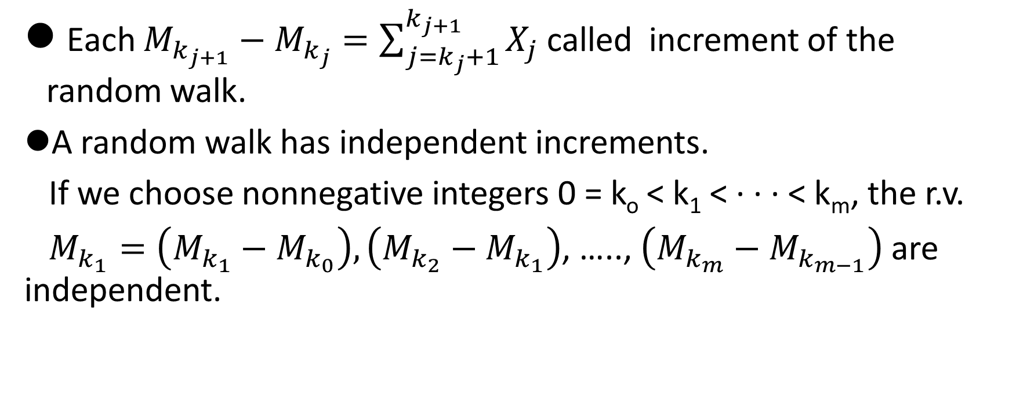
3.2.2 Indep. Increments
Each $M_{k_{j+1}}−$ $M_{k_{j}}=\sum_{j=k_{j}+1}^{k_{j+1}}{X_{j}}$called increment of the random walk.
A random walk has independent increments.
If we choose nonnegative integers 0 = k_{o} < k₁ < · · · < k_{m}, the r.v.
$M_{k_{1}}=\left(M_{k_{1}}−M_{k_{0}}\right),\left(M_{k_{2}}−M_{k_{1}}\right)$, ….., $\left(M_{k_{m}}−M_{k_{m−1}}\right)$are independent.

Slide 4
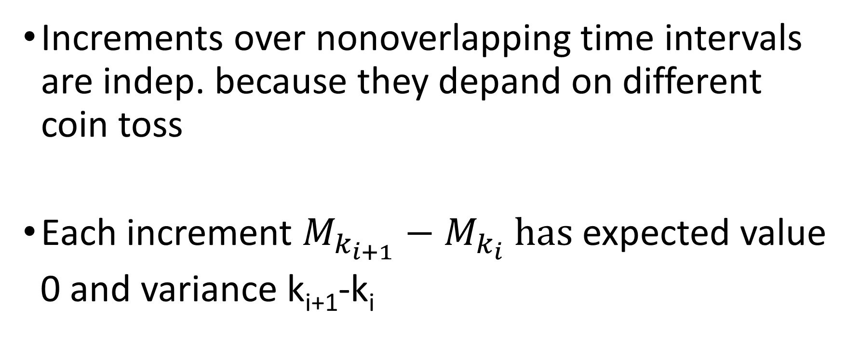
Properties of Random Walks
Increments over nonoverlapping time intervals are indep. because they depand on different coin toss
Each increment $M_{k_{i+1}}−$ $M_{k_{i}} has$expected value
0 and variance k_{i+1}-k_{i}

Slide 5
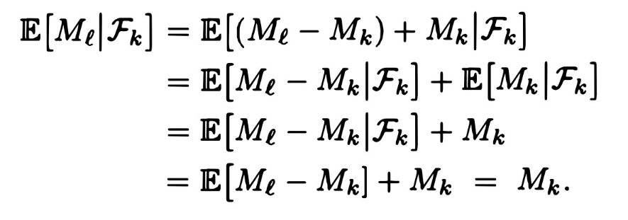
Martingale Property for the Symmetric Random Walk
Choose nonnegative integers k < l and compute
Note (M_{l} – M_{k})和F_{k}獨立

Slide 6
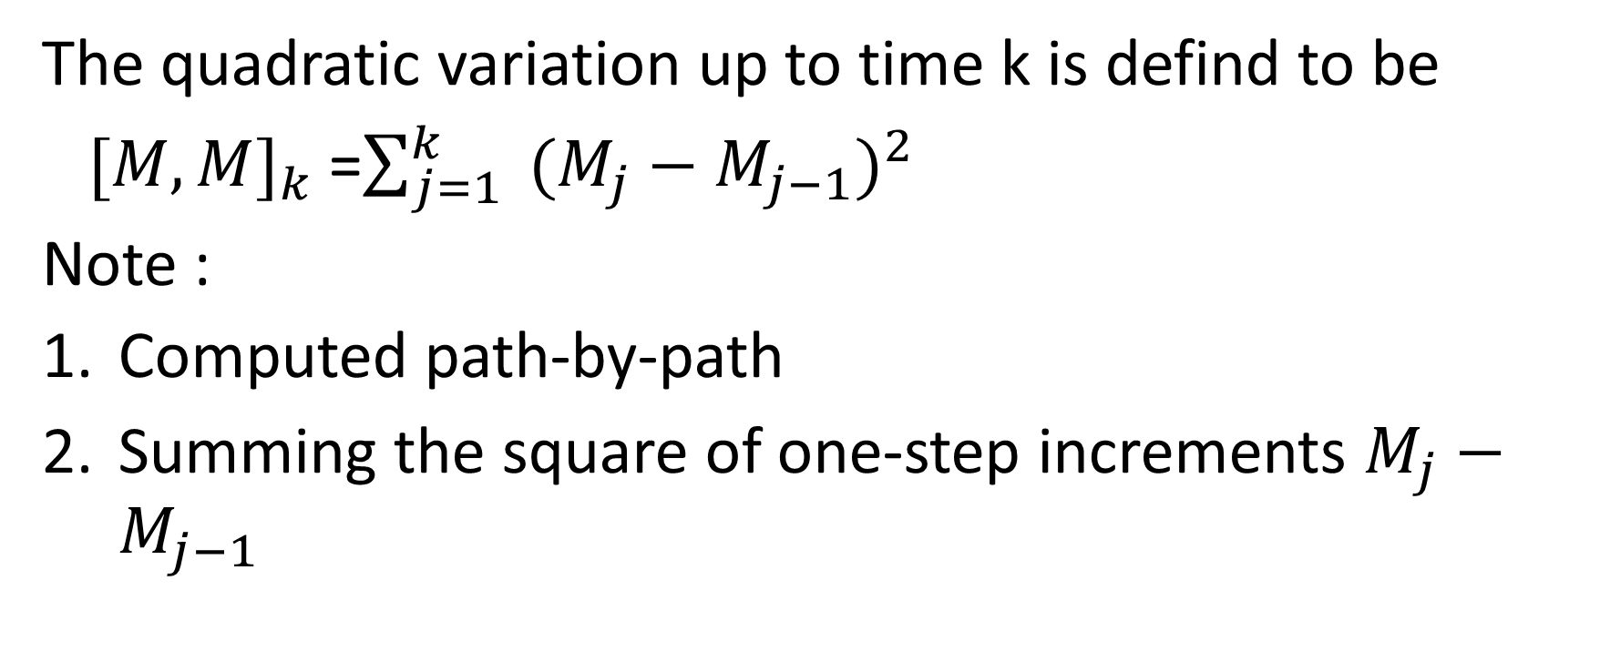
Quadratic Variation of the Symmetric Random Walk
The quadratic variation up to time k is defind to be
${[M,M]}_{k}$=$\sum_{j=1}^{k}{ {(M_{j}−M_{j−1})}^{2}}$
Note :
Computed path-by-path
Summing the square of one-step increments $M_{j}−M_{j−1}$

Slide 7
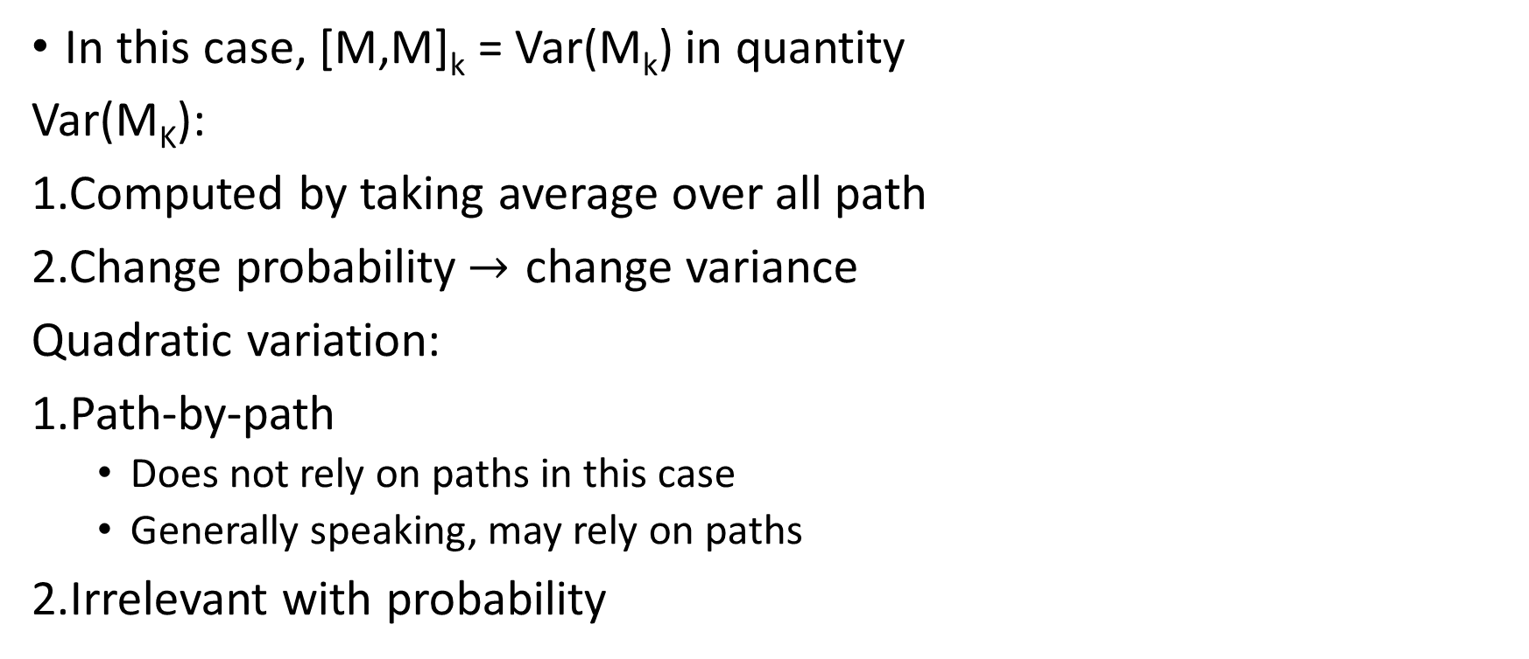
Difference between [M,M]_{k} & Var(M_{k})
In this case, [M,M]_{k} = Var(M_{k}) in quantity
Var(M_{K}):
1.Computed by taking average over all path
2.Change probability$→$ change variance
Quadratic variation:
1.Path-by-path
Does not rely on paths in this case
Generally speaking, may rely on paths
2.Irrelevant with probability

Slide 8
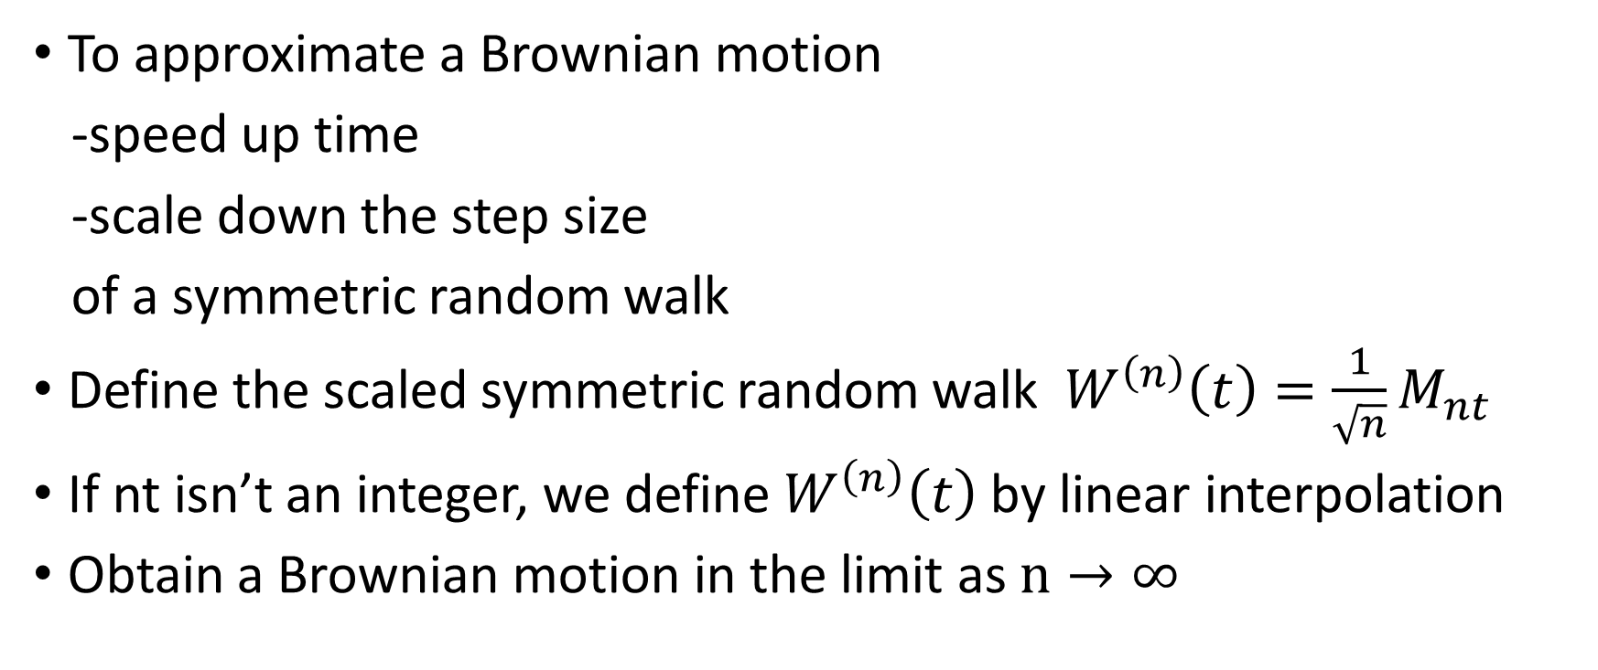
Scale Symmetric Random Walk
To approximate a Brownian motion
-speed up time
-scale down the step size
of a symmetric random walk
Define the scaled symmetric random walk$W^{\left(n\right)}\left(t\right)=\frac{1}{\sqrt{n}}M_{nt}$
If nt isn’t an integer, we define $W^{\left(n\right)}\left(t\right)$ by linear interpolation
Obtain a Brownian motion in the limit as $n→∞$

Slide 9
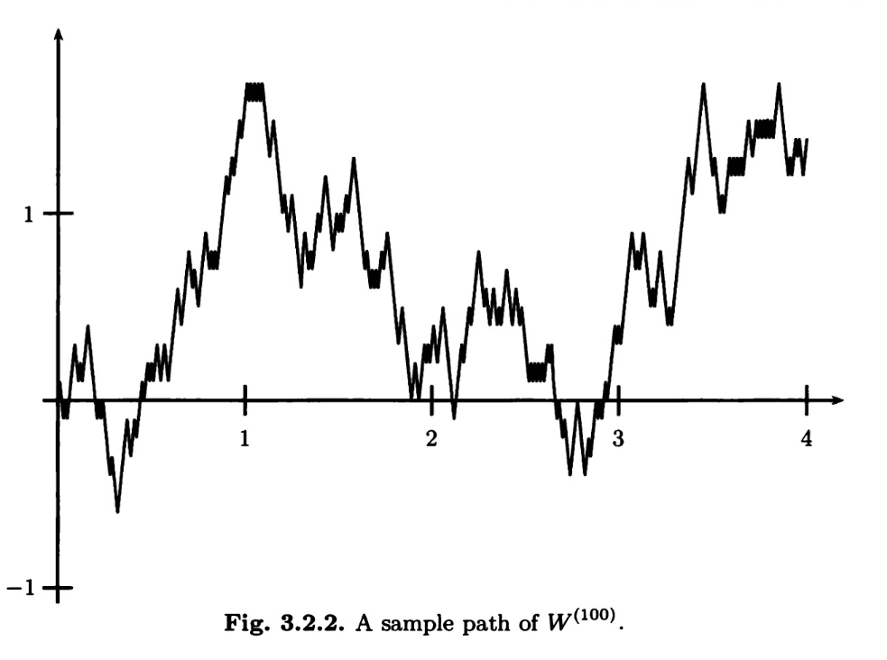
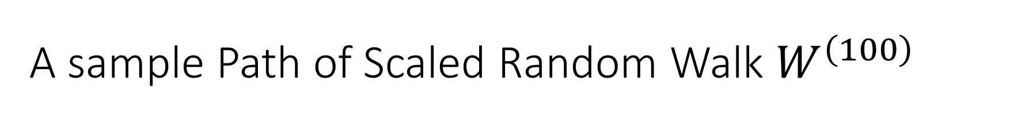
A sample Path of Scaled Random Walk $W^{\left(100\right)}$

Slide 10
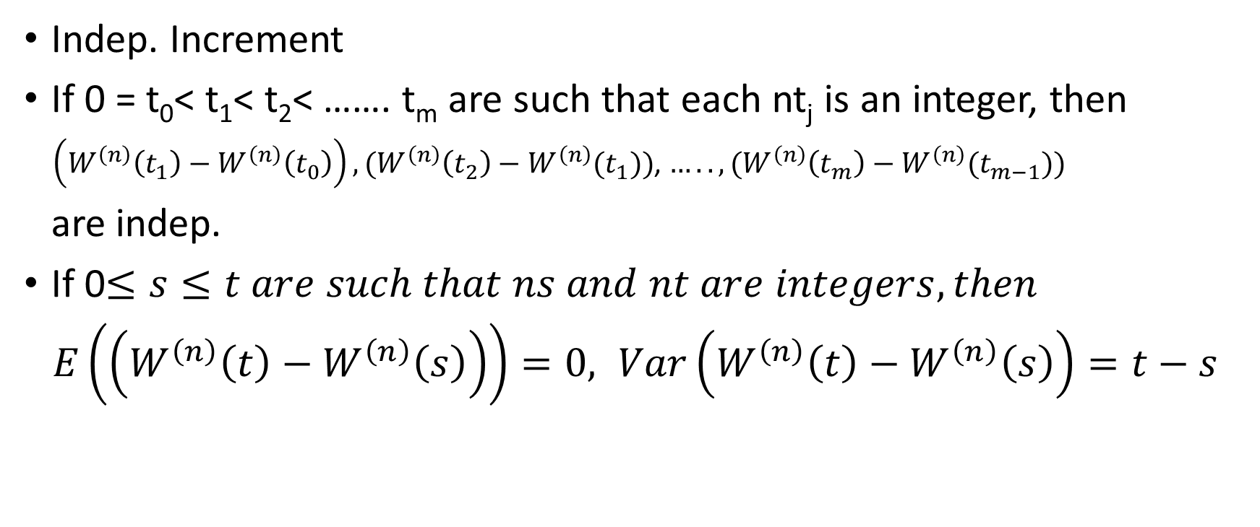
Property of Scale Random Walk
Indep. Increment
If 0 = t₀< t₁< t₂< ……. t_{m} are such that each nt_{j} is an integer, then
$\left(W^{\left(n\right)}\left(t_{1}\right)−W^{\left(n\right)}\left(t_{0}\right)\right),(W^{\left(n\right)}\left(t_{2}\right)−W^{\left(n\right)}(t_{1}))$, $…..,(W^{\left(n\right)}\left(t_{m}\right)−W^{\left(n\right)}(t_{m−1}))$
are indep.
If 0$≤s≤t are such that ns and nt are integers, then$
$E\left(\left(W^{\left(n\right)}\left(t\right)−W^{\left(n\right)}\left(s\right)\right)\right)=0, Var\left(W^{\left(n\right)}\left(t\right)−W^{\left(n\right)}\left(s\right)\right)=t−s$

Slide 11
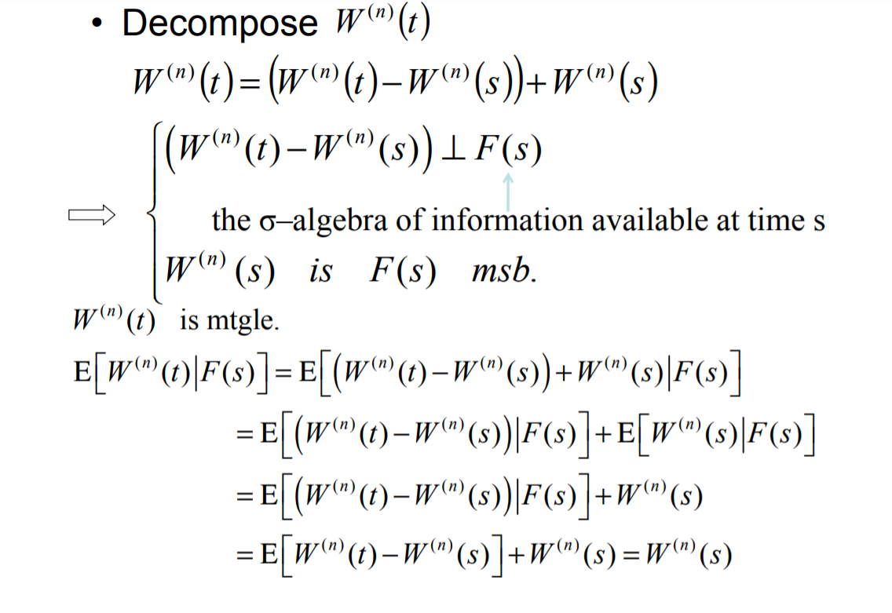

Slide 12

Quadratic Variation
$$\left[W^{\left(n\right)},W^{\left(n\right)}\right]\left(t\right)=\sum_{j=1}^{nt}{{[W^{\left(n\right)}\left(\frac{j}{n}\right)−W^{\left(n\right)}\left(\frac{j−1}{n}\right)]}^{2}}$$
$$=\sum_{j=1}^{nt}{{[\frac{1}{\sqrt{n}} X_{j}^{}]}^{2}}=\sum_{j=1}^{nt}{\frac{1}{n}}=t$$

Slide 13
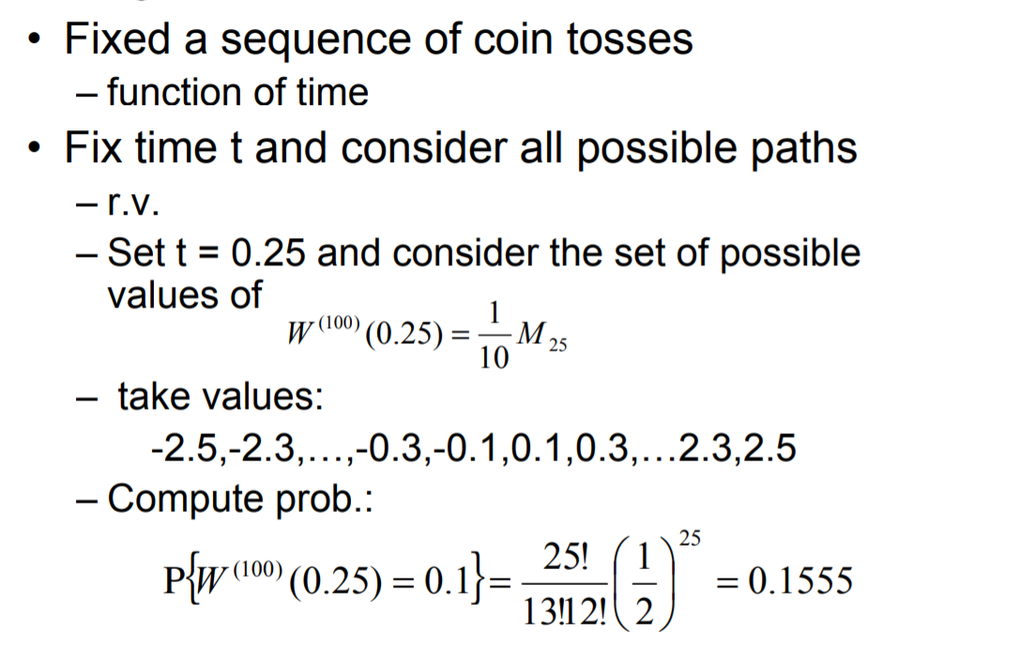
Limiting Distribution of the Scaled Random Walk

Slide 14
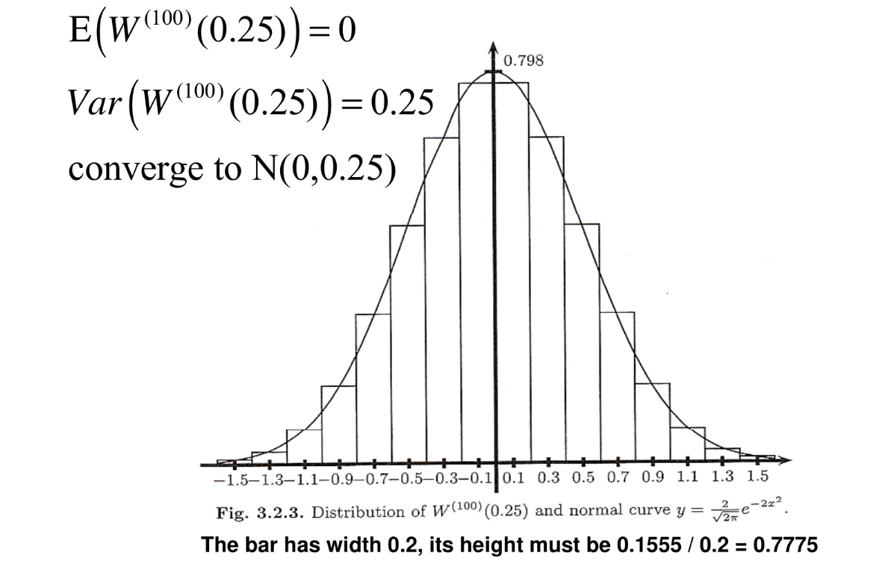

Slide 15
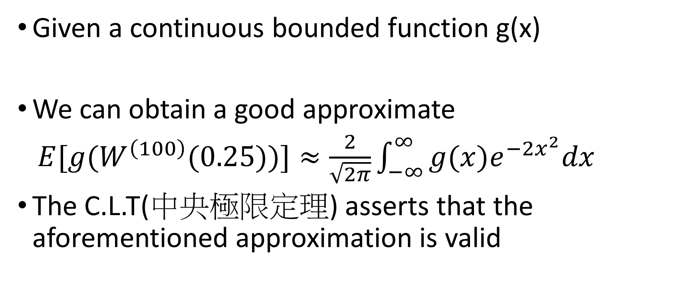
Approximate the Integer
Given a continuous bounded function g(x)
We can obtain a good approximate
$E[g(W^{\left(100\right)}(0.25))]≈\frac{2}{\sqrt{2π}}\int_{−∞}^{∞}{g(x)e^{−2x^{2}}dx}$
The C.L.T(中央極限定理) asserts that the aforementioned approximation is valid

Slide 16
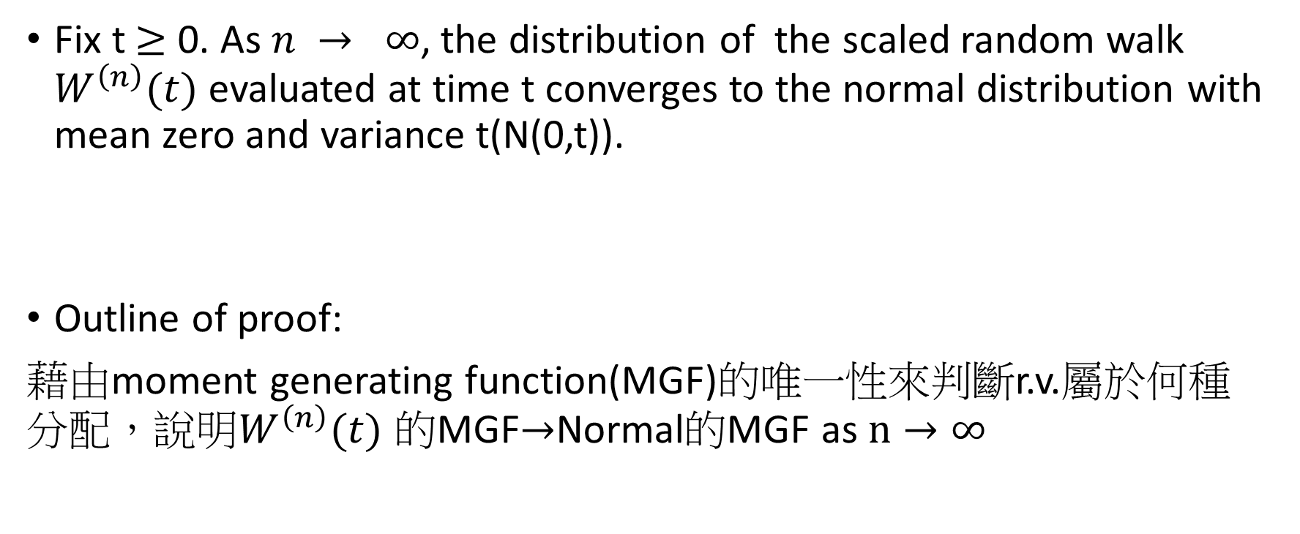
Thm. 3.2.1 Central limit Thm.
Fix t $≥$ 0. As $n → ∞$, the distribution of the scaled random walk $W^{\left(n\right)}(t)$ evaluated at time t converges to the normal distribution with mean zero and variance t(N(0,t)).
Outline of proof:
藉由moment generating function(MGF)的唯一性來判斷r.v.屬於何種 分配，說明$W^{\left(n\right)}(t)$ 的MGF$→$Normal的MGF as $n→∞$

Slide 17
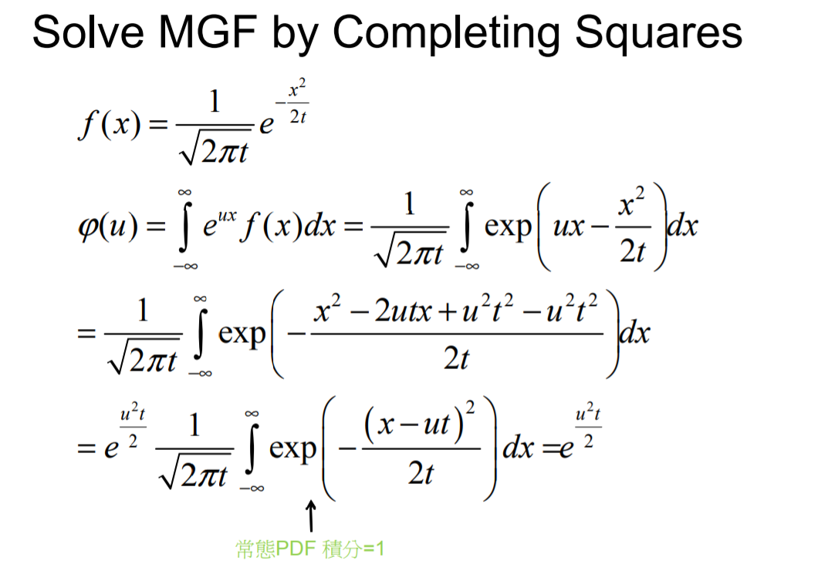

Slide 18
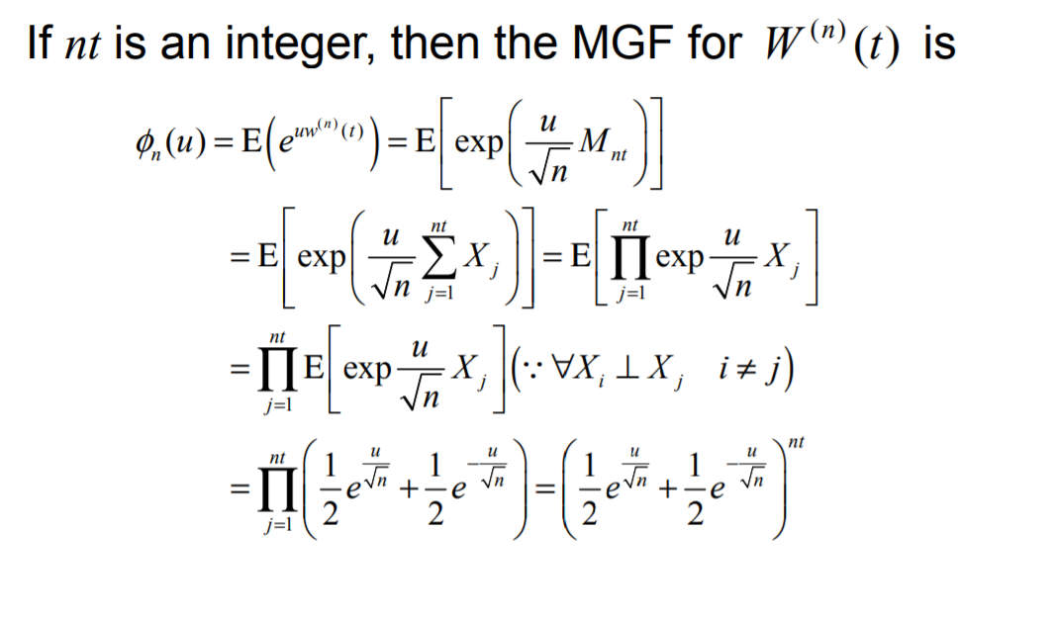

Slide 19
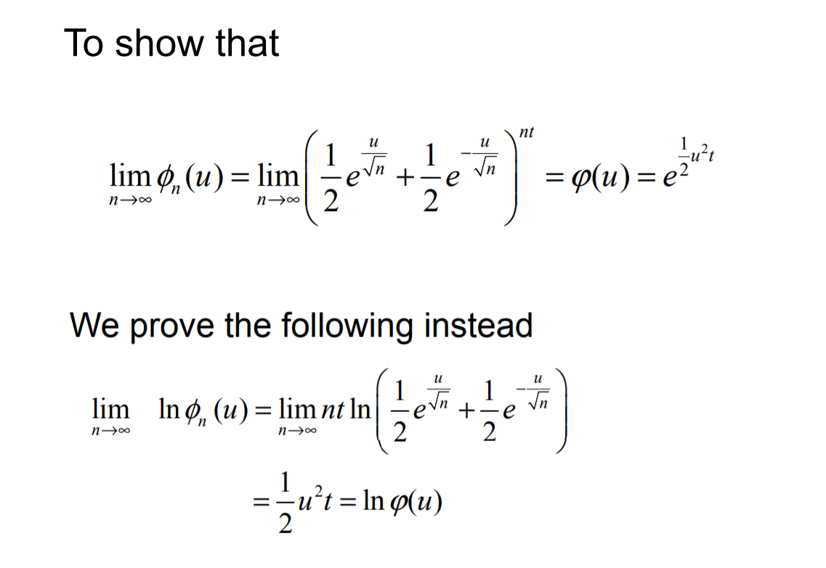

Slide 20
